Slide 1
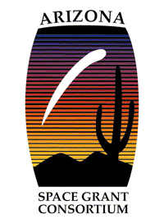
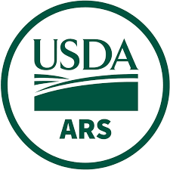
A Web Based Tool for Vegetation Assessment in the Altar Valley
John Esparza
Mentors: Mary Nichols, Octavia Crompton
United States Department of Agriculture – Agricultural Research Service Southwest Watershed Research Center
Arizona NASA Space Grant Consortium Student Research Symposium, Hilton Tucson East, 7600 E Broadway Blvd., Tucson, AZ 85710
April 20, 2024

Slide 2
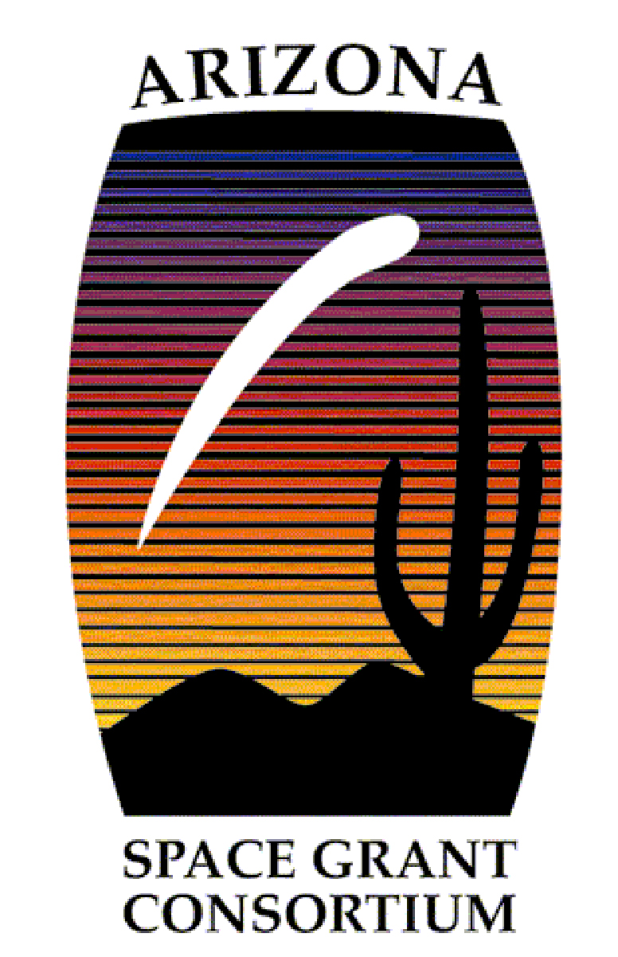
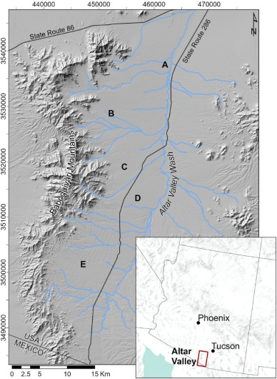
Motivation
The Altar Valley
A 600k acre semiarid watershed in southern Arizona
80% of the valley supports agricultural operations
Beginning in the 1930s, hundreds of earthen berms were constructed to control surface runoff and harvest water
Figure 1: Altar Valley graphic from the USDA-ARS
1
Notes:
Across the western US the dominant agricultural land use is livestock production (Starrs, 1998, Sheridan, 2012, Sheridan et al., 2015). Within the state of Arizona, approximately 98% of agricultural lands are grazing lands that cover approximately 73% of the total land area (Kerna et al., 2014). Although livestock were introduced in the 1500 s in the southwestern US (Hamilton, 1884), the expansion of ranching operations, on both private and public land, was limited by access to water. Water development was rapid once well drilling and pumping equipment became available in the late 1800 s (Wood et al., 2005) after which livestock numbers increased substantially in response to both transcontinental railroad construction and water access throughout the western US (Wagoner, 1952).
More on berms
Create stock tanks, farm ponds
Reduce runoff velocity, increase soil moisture, enhance vegetation production
A 600k acre semiarid watershed in southern Arizona
80% of the valley supports agricultural operations, so water management is crucial
Beginning in the 1930s, hundreds of earthen berms were constructed to control surface runoff and harvest water.
Man-made soil structures unnatural to the environment
There have been recent inventories of berms in the Altar valley, so we know where they are.
However, impact of berms on vegetation is poorly documented
Watershed- A watershed is an area of land where all flowing surface water converges to a single point, such as a river mouth, or flows into another body of water, such as a lake or ocean.

Slide 3
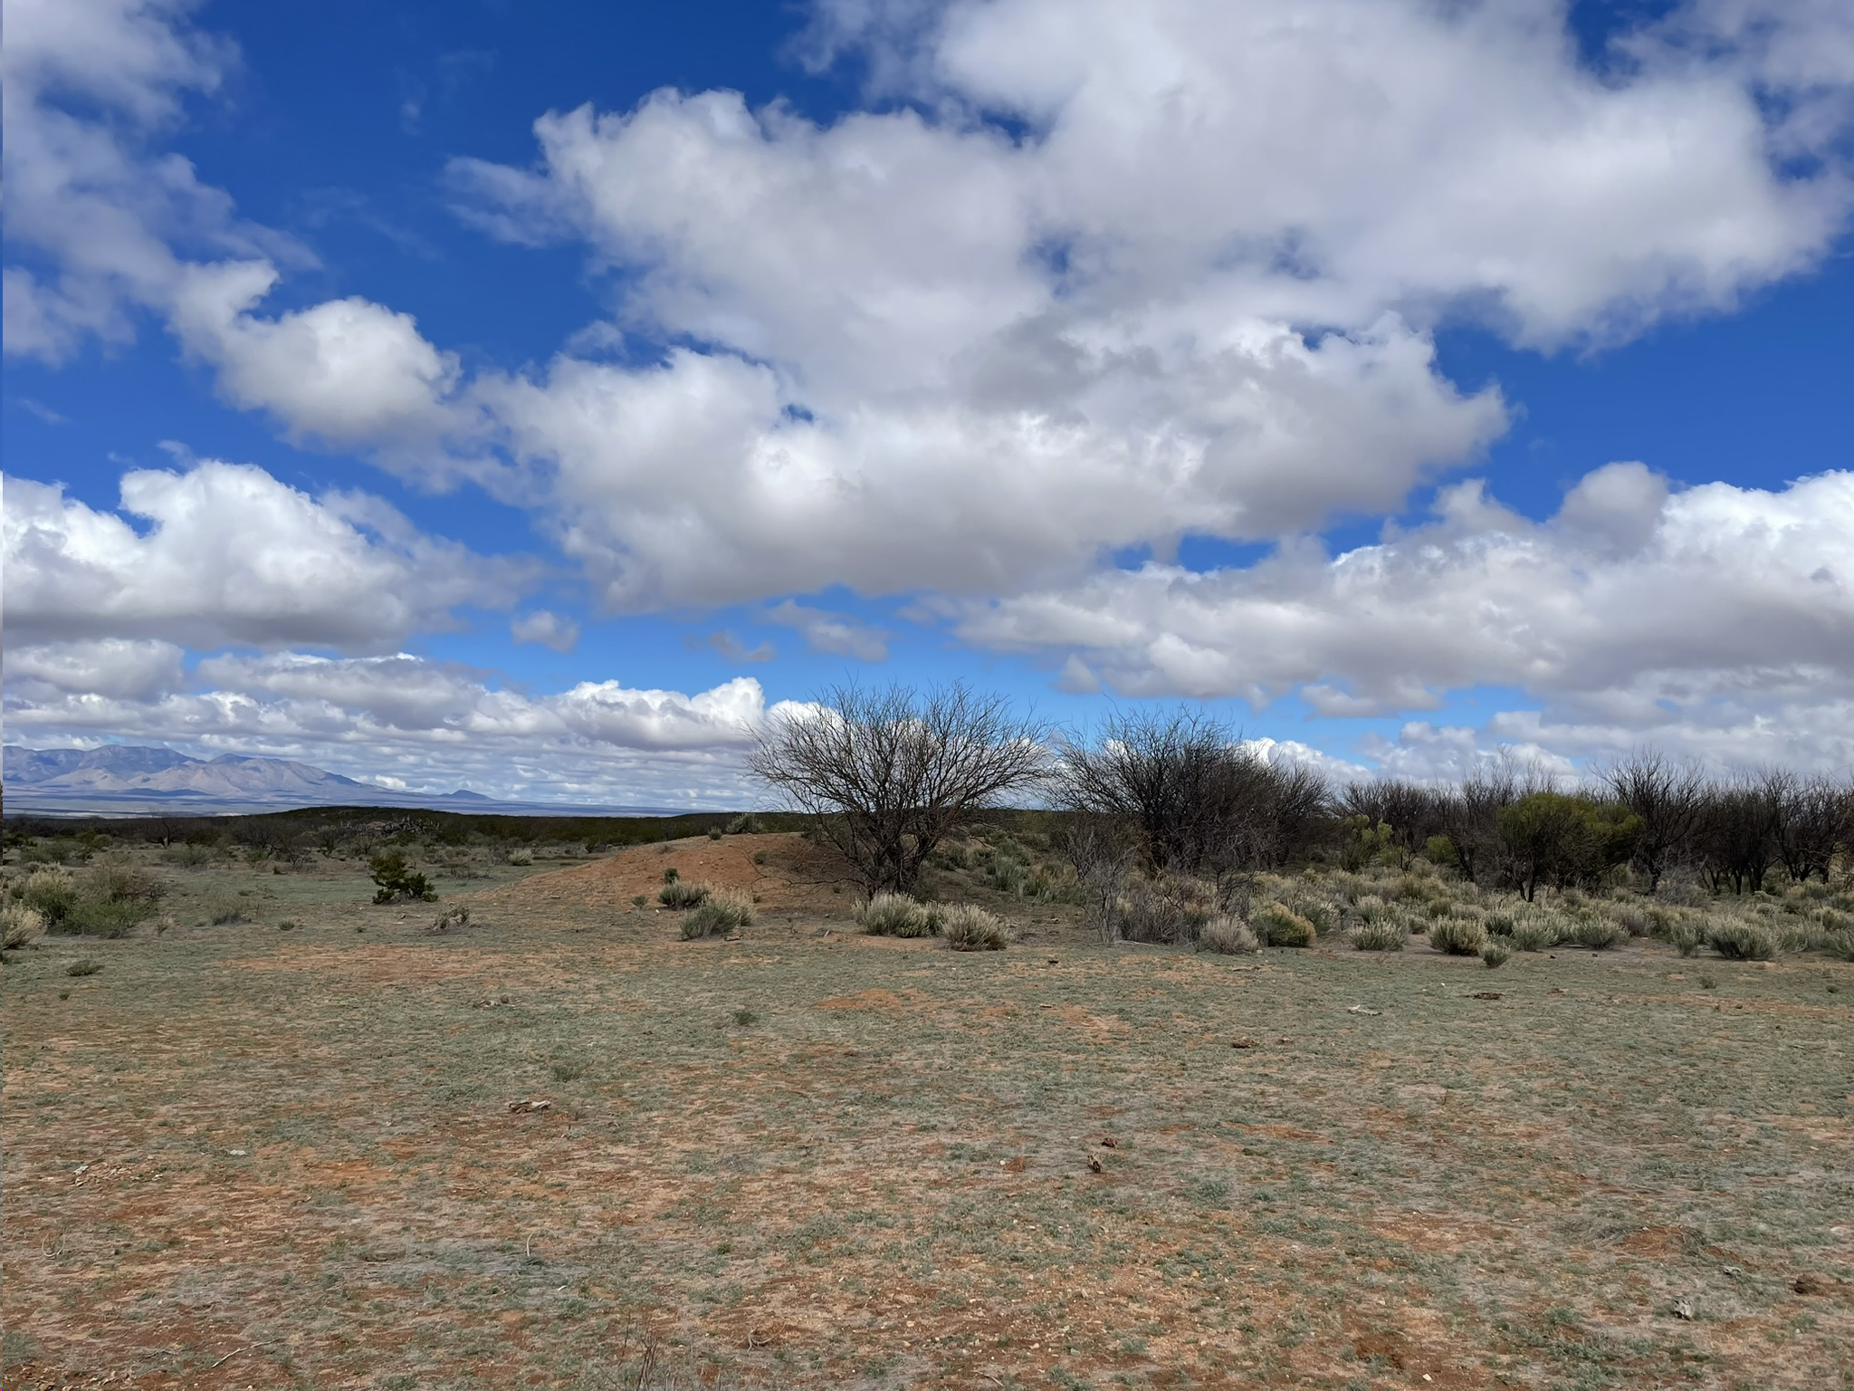
Motivation
Berms
Man-made alteration of surface topography
There have been recent inventories of berms in the Altar valley, so we know where they are.
However, impact of berms on vegetation is poorly documented
Berm in Tombstone, Arizona
2

Slide 4
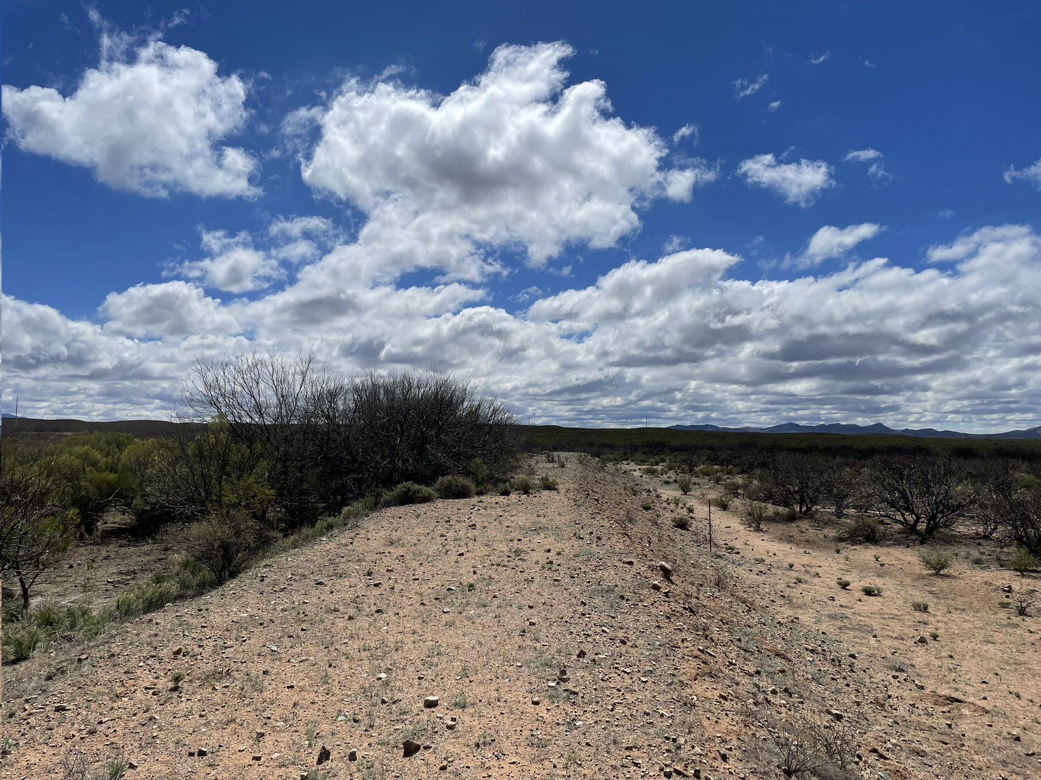
Motivation
Berm in Tombstone, Arizona
3

Slide 5
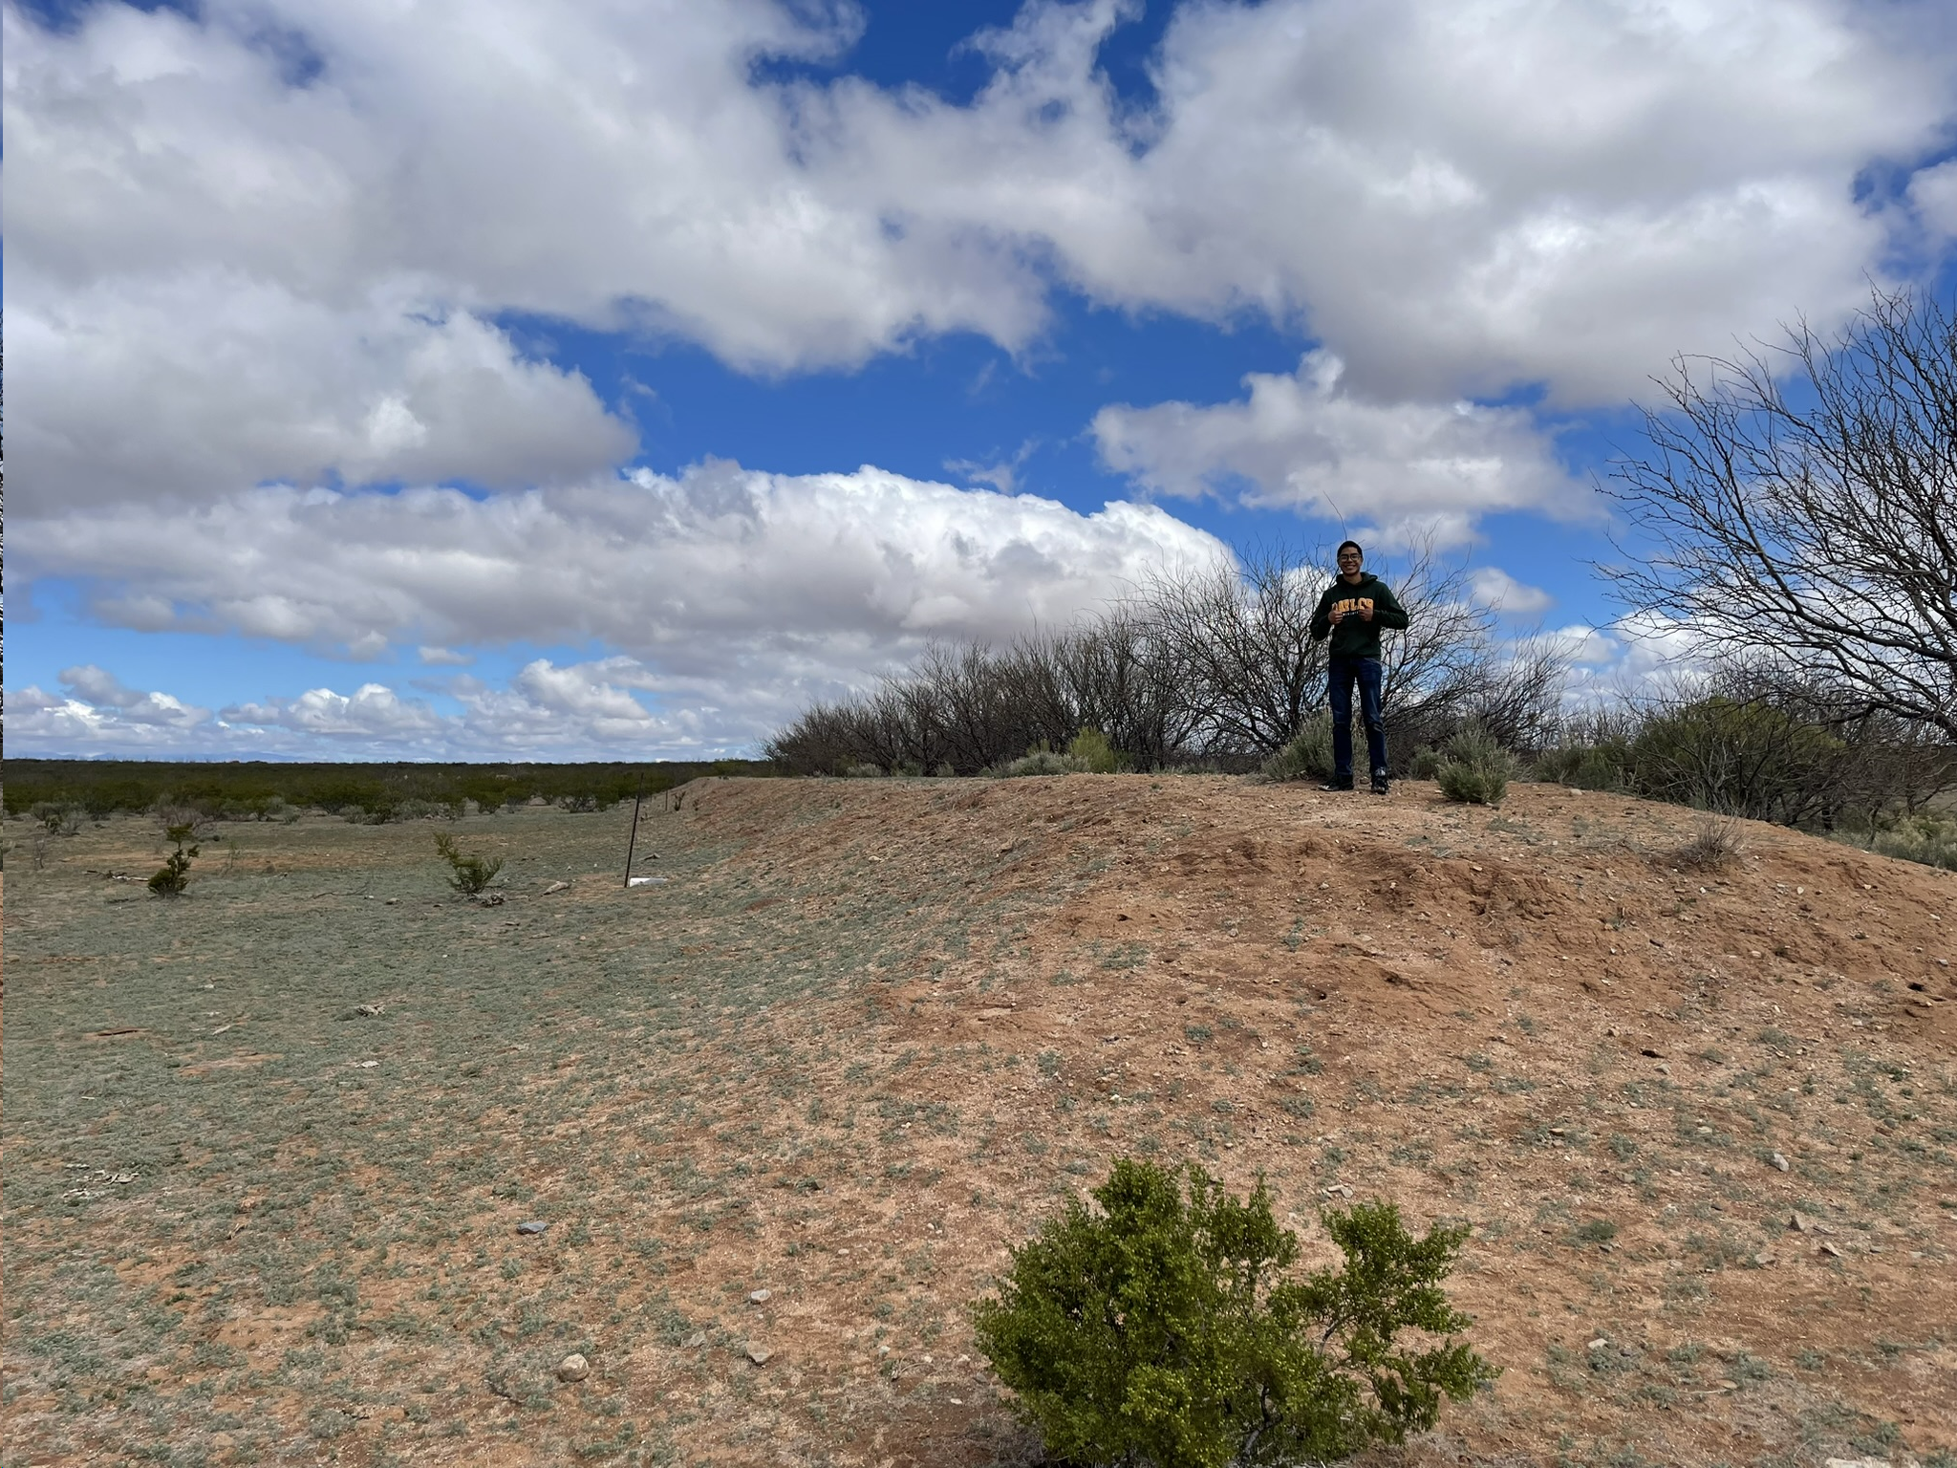
Motivation
4
John on a berm in Tombstone, Arizona

Slide 6
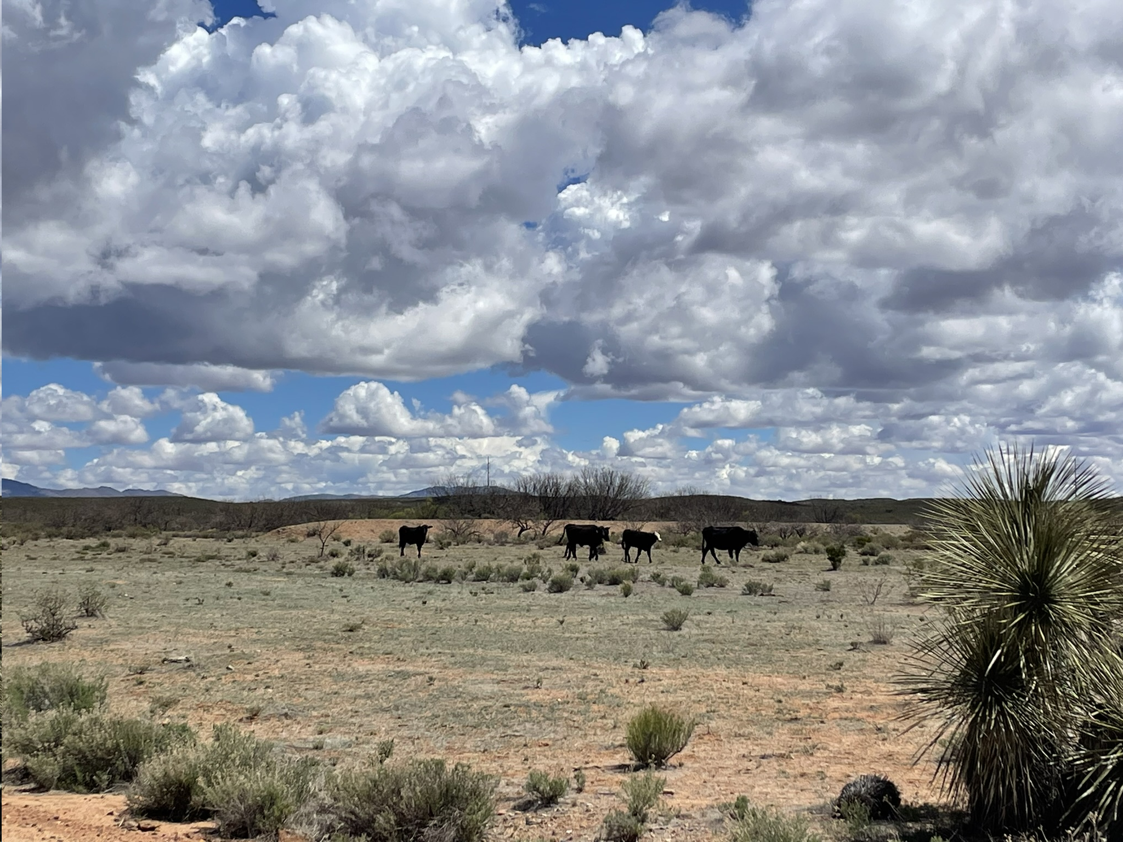
Motivation
5
Cows near a berm in Tombstone, Arizona

Slide 7
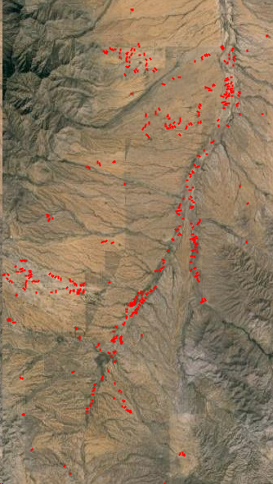
Objective
Develop a web app to assess berm impacts on proximal vegetation using remote sensing vegetation indices.
Enabling land managers and stakeholders to assess vegetation growth upslope and downslope of berms
Vegetation Indices = A remote sensing technique used to identify vegetation and measure its health and vitality.
Normalized Difference Vegetation Index (NDVI)
Soil-Adjusted Vegetation Index (SAVI)
Figure 2: Berm locations in a section of the Altar Valley, Google Earth Engine
6
Notes:
NDVI is one of the most commonly used vegetation indices in remote sensing. It measures the difference between near-infrared (NIR) and red light reflectance, providing an indication of vegetation density and health.
SAVI is a vegetation index designed to reduce the influence of soil brightness when assessing vegetation density. It was developed to address the limitations of other vegetation indices, such as NDVI, which can be sensitive to variations in soil reflectance. This is especially helpful in desert areas like the Altar Valley, where the soil is bright. Additionally, SAVI has a soil adjustment factor to help contrast between vegetation and vare soil, making it better suited for detecting and quantifying sparse vegetation in desert landscapes.
Landsat and Sentinel are two prominent satellite programs that provide valuable Earth observation data for a wide range of applications, with Landsat being operated by USGS/NASA and Sentinel by European Space Agnecy (ESA) as part of the Copernicus program.
spectral imaging transformation of two or more image bands designed to enhance the contribution of vegetation properties and allow reliable spatial and temporal inter-comparisons of terrestrial photosynthetic activity and canopy structural variations.

Slide 8
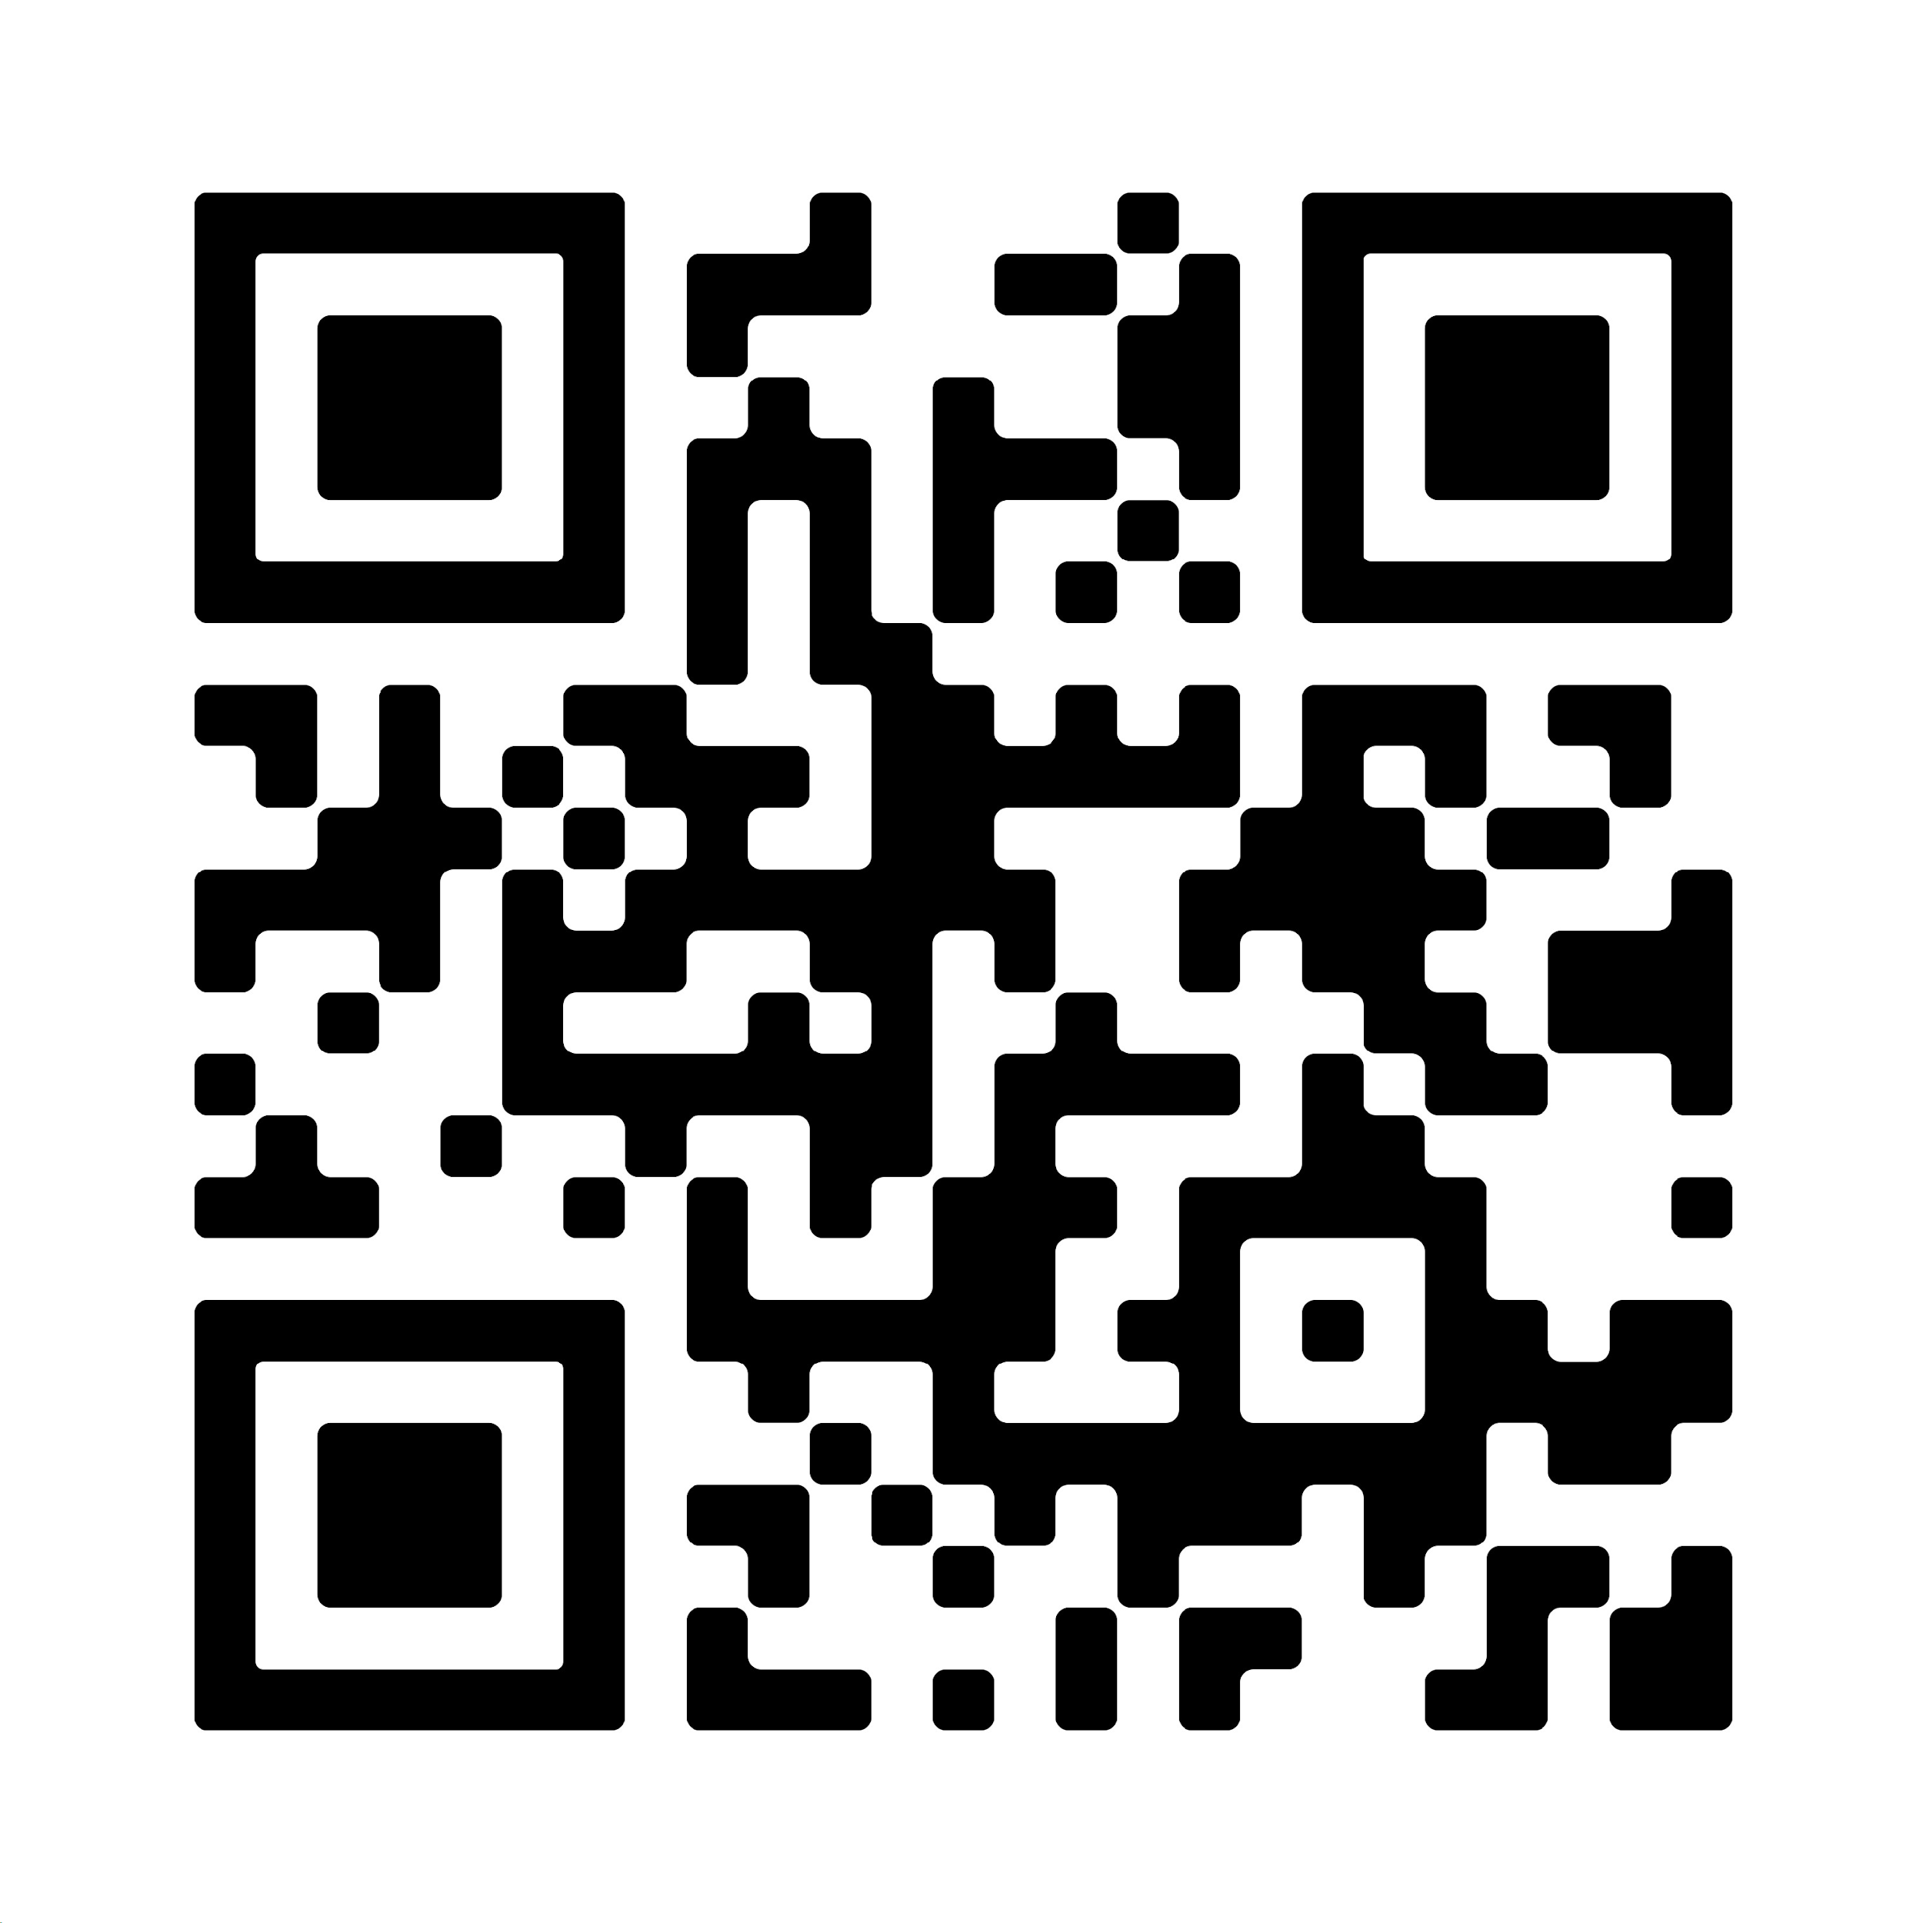
Google Earth Engine
A cloud based geospatial analysis platform
Massive Data Archive
Cloud Based Processing allows for complex analysis through a programming interface.
Earth Engine Apps allow users to access google earth engine without code.
Figure 3: QR link to my web app
7
Notes:
Massive Data Archive
Vast collection of satellite imagery datasets
Cloud Based Processing allows for complex analysis through a programming interface.
Earth Engine Apps allow users to access google earth engine without code.
Dynamic, shareable user interfaces Earth for Engine Analyses
Easy to Use
Accessible via application specific URL
No Earth Engine experience needed
https://ee-wholenote4.projects.earthengine.app/view/berm-influences-on-savi-and-ndvi-in-the-altar-valley

Slide 9
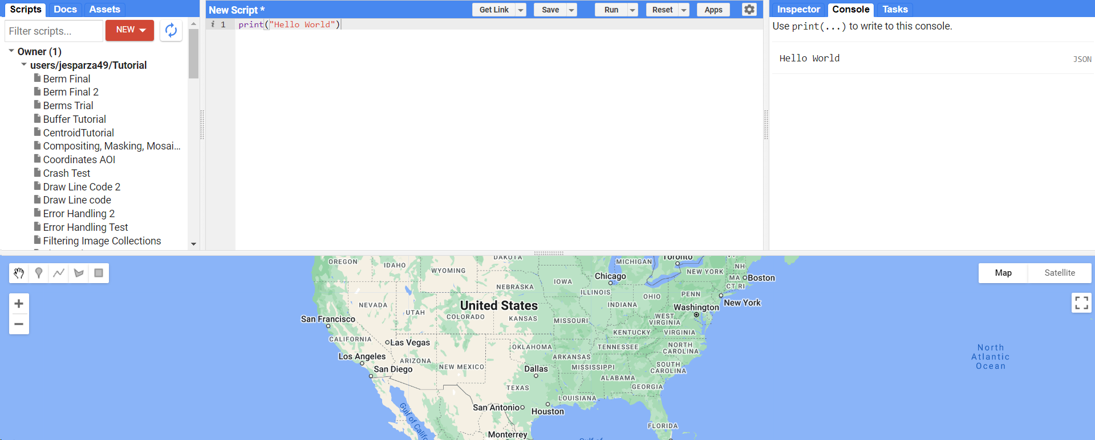
Google Earth Engine
8

Slide 10
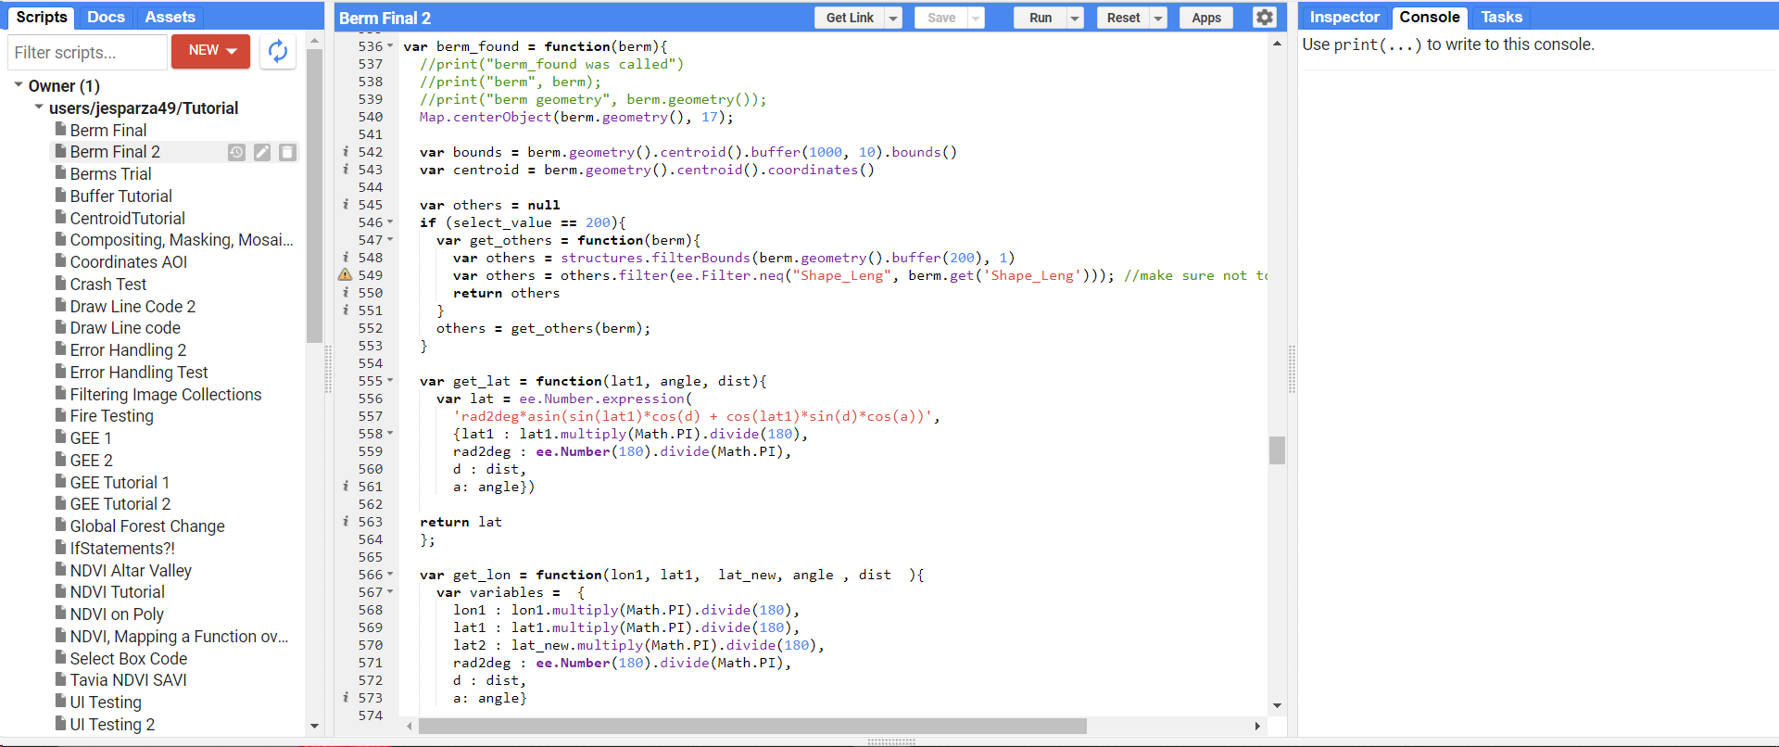
The Web App
9

Slide 11
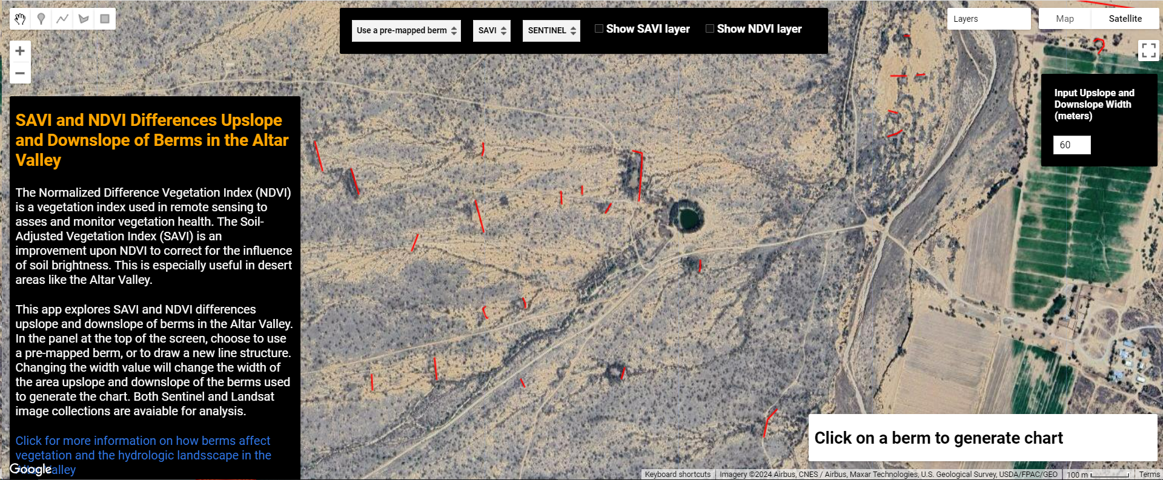
The Web App
10

Slide 12
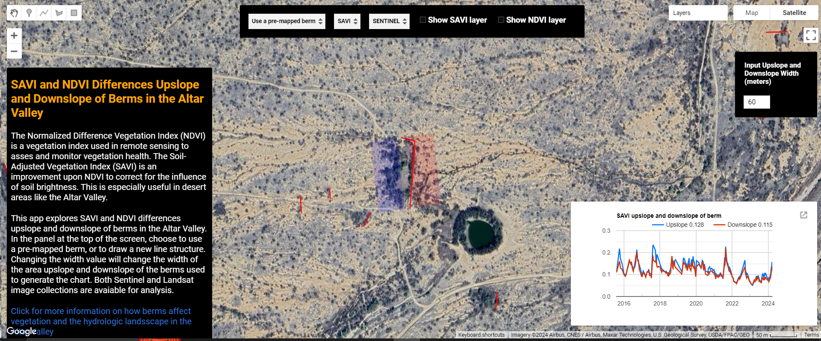
The Web App
11

Slide 13
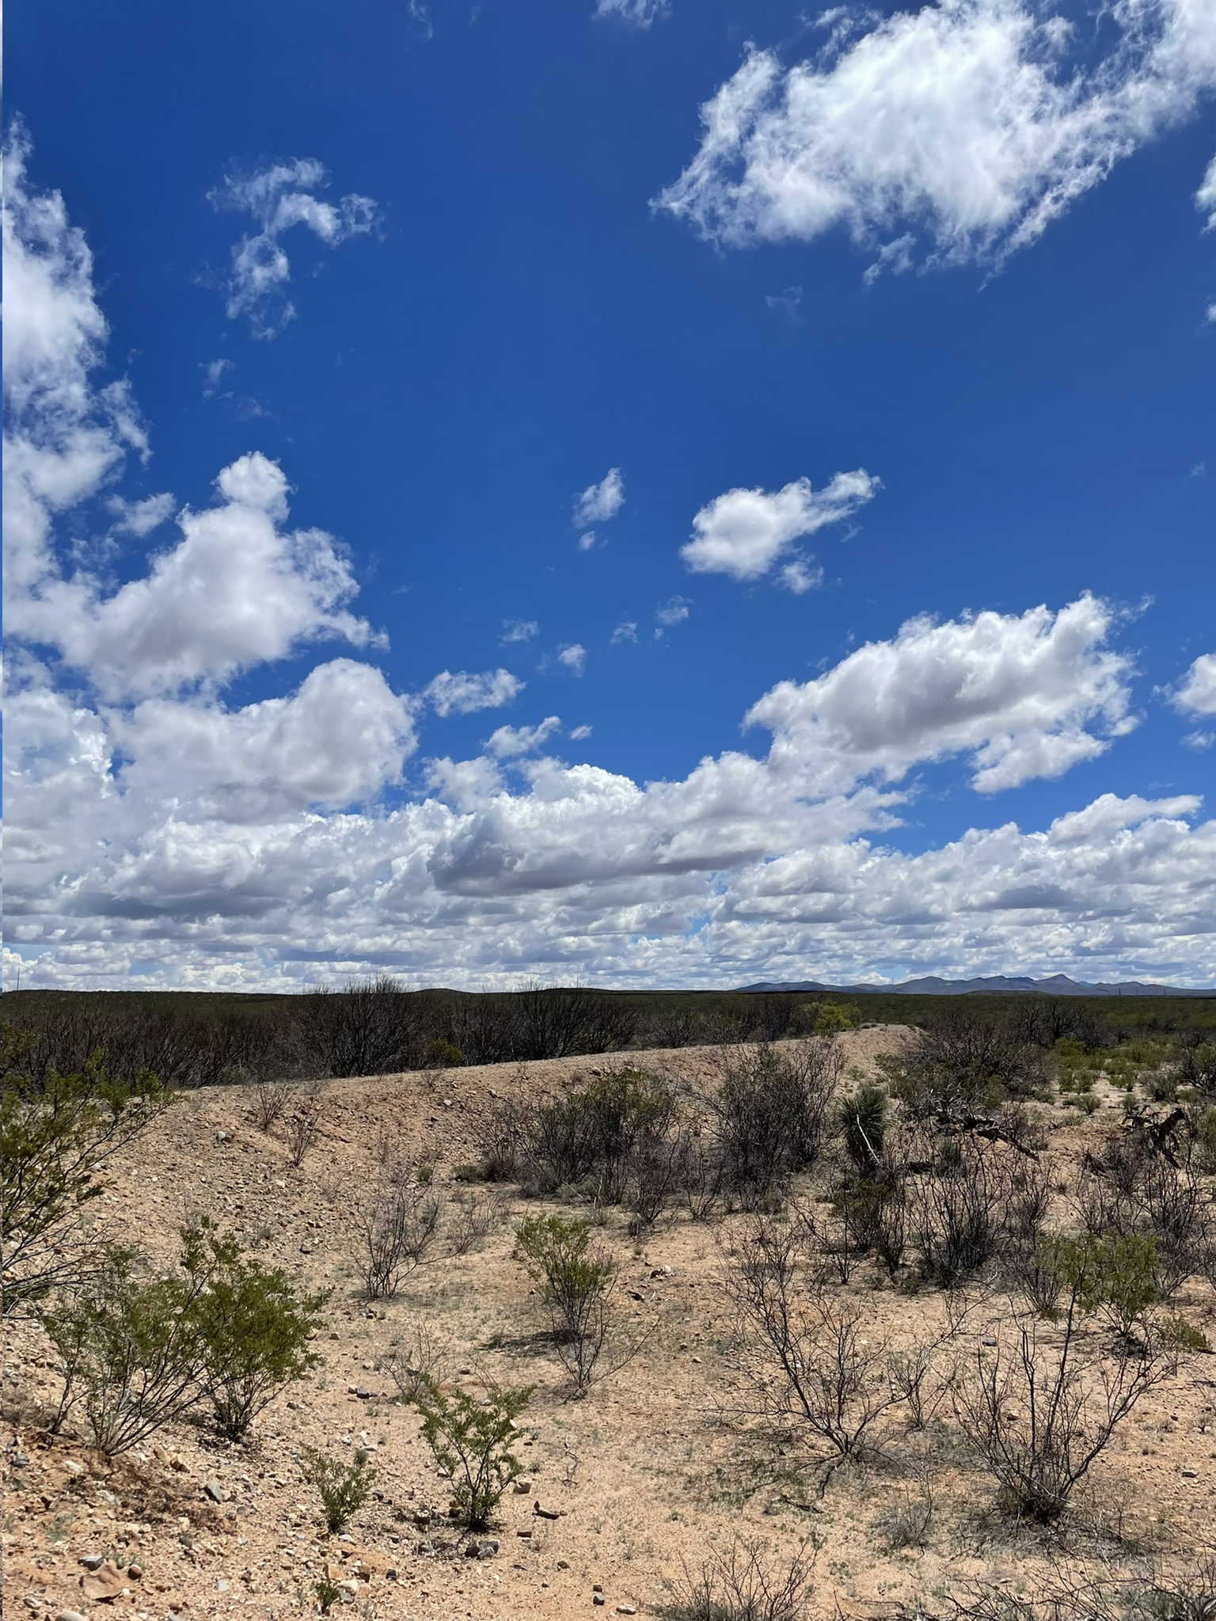
Conclusions
Ability to quantify berm impacts on vegetation over time
User can analyze known or potential berms
Extended to any area where SAVI and NDVI are available
Provide land managers with new information to support management decisions
Berm in Tombstone, Arizona
12
Notes:
Take away progress bar
Declutter!
Take out code slide
Demo the app!
Clean up title slide
Define watershed.
Take away formulas for NDVI and SAVI, just explain it.

Slide 14
Thank you

